Slide 1

Introduction to Completeness Verification
Completeness verification is an essential process in ensuring the accuracy and reliability of data. It involves the comprehensive evaluation of datasets to confirm that they contain all the necessary information required for their intended use. This crucial step is vital in various industries, including e-commerce, finance, and healthcare, where data integrity is paramount.

Slide 2
Importance of Catalog Completeness
Data Accuracy
Search Visibility
Decision Making
Having a complete catalog ensures that the data provided to users is accurate and reliable, leading to enhanced customer satisfaction and trust.
A complete catalog improves search engine visibility, resulting in increased traffic and better user engagement.
Complete catalogs enable informed decision-making by providing comprehensive information for users and stakeholders.

Slide 3
Definition of Minimum Attribute Information
1
Key Attributes
2
Use Case Specific
3
Quality Standards
Minimum attribute information refers to the essential data elements required for a dataset to be considered complete.
The specific attributes needed may vary depending on the use case and the intended audience of the catalog.
Minimum attribute information aligns with quality standards and ensures data consistency and accuracy.

Slide 4
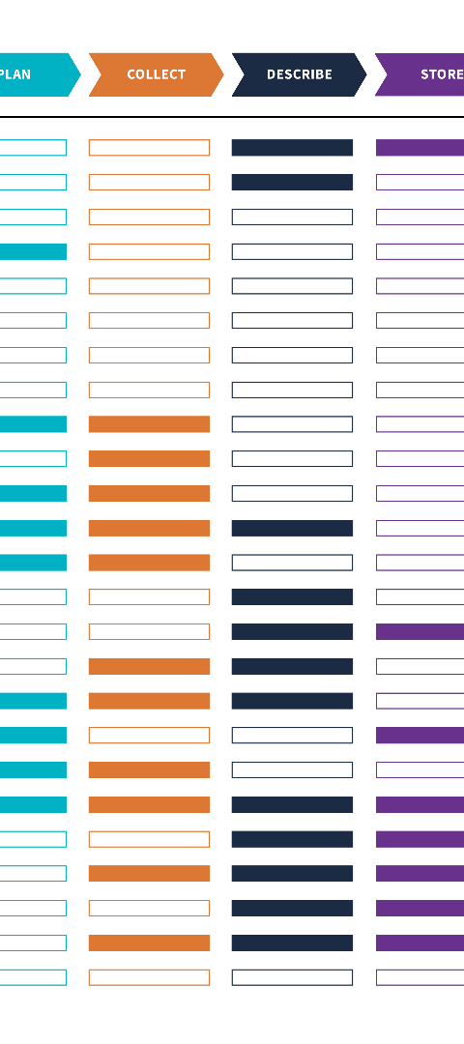



Test Case: In-depth Evaluation of Catalog Completeness
Data Collection
Collect all attribute information required for the test case evaluation.
Evaluation Process
Conduct an in-depth analysis of the catalog data to assess completeness and accuracy.
Reporting
Present detailed findings and recommendations based on the evaluation results.

Slide 5
Methodology for Conducting the Test Case
Data Collection
Evaluation Criteria
Analysis Approach
Specify the sources and procedures for collecting the catalog data for evaluation.
Define the specific criteria and parameters used to assess the completeness of the catalog.
Outline the approach for analyzing the collected data to draw meaningful conclusions.

Slide 6

Analysis of Results and Findings
1
Evaluation
Thoroughly evaluate the completeness of the catalog based on the defined criteria.
2
Findings
Present the key findings and insights gained from the catalog completeness evaluation process.
3
Recommendations
Provide actionable recommendations for addressing any identified gaps in the catalog completeness.

Slide 7

Recommendations for Improving Catalog Completeness
Data Standardization
Training and Awareness
Continuous Monitoring
Implement standardized templates and guidelines for catalog data entry and maintenance.
Provide training to stakeholders on the importance of complete and accurate catalog information.
Establish processes for ongoing monitoring and auditing of catalog completeness.

Slide 8
Conclusion and Key Takeaways
1
2
3
Data Quality
User Satisfaction
Business Performance
Ensuring catalog completeness is fundamental in upholding data quality, driving user satisfaction, and positively impacting business performance.

